Slide 1

RESCQ: Realtime Scheduling for Continuous Angle Quantum Error Correction Architectures
In Proceedings of ASPLOS ‘25, March 30-April 3, 2025
Sayam Sethi, Jonathan Baker
Chandra Family Department of Electrical and Computer Engineering, The University of Texas at Austin

Slide 2
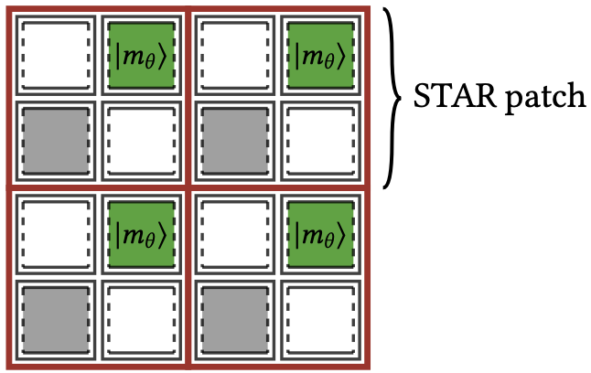
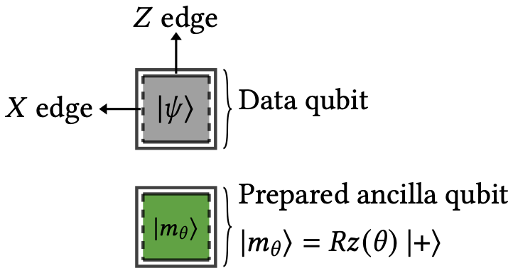
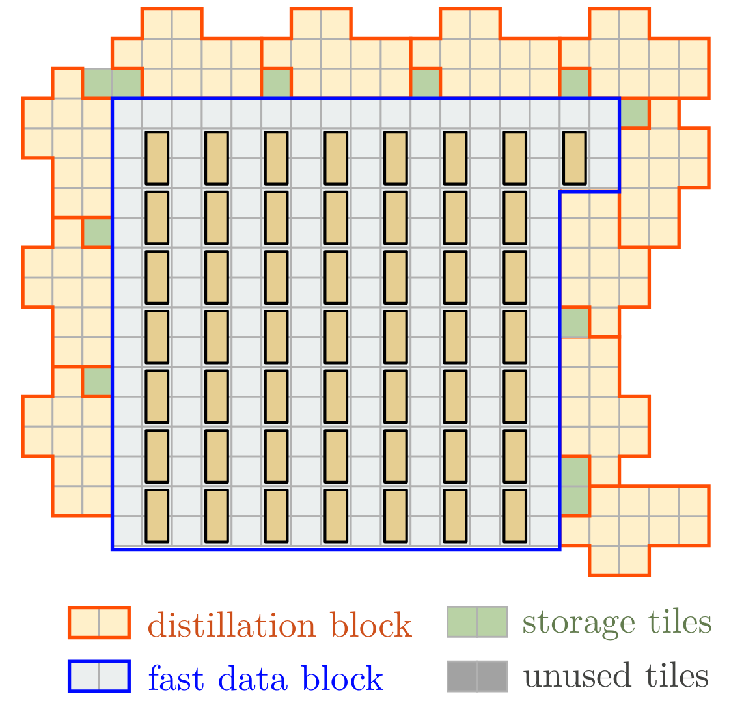
Introduction
To realize large scale QEC (on surface codes), resource states, such as |𝑇⟩, must be prepared which is expensive in both space and time.
In order to circumvent this problem, alternatives have been proposed, such as the production of continuous angle rotation states [1, 6, 34].

Slide 3
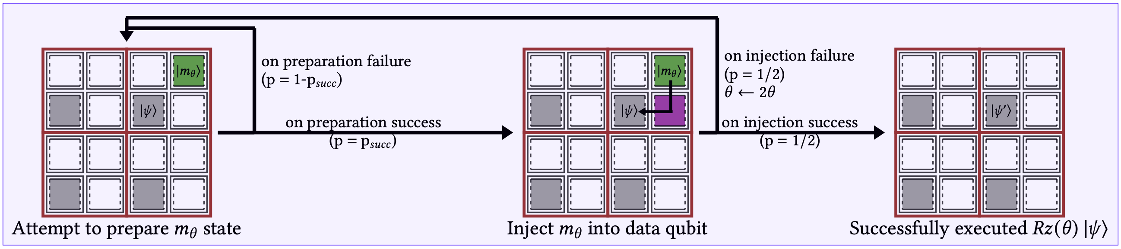
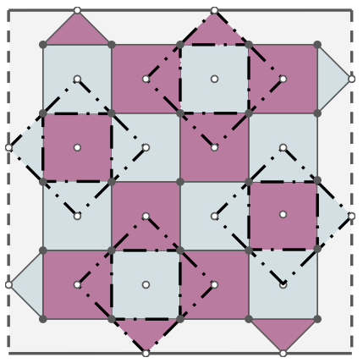
Introduction
BASELINE APPROACH
However, the production of these states is non-deterministic and may require multiple repetitions to succeed.
The original proposals suggest architectures which do not account for realtime management of resources.

Slide 4
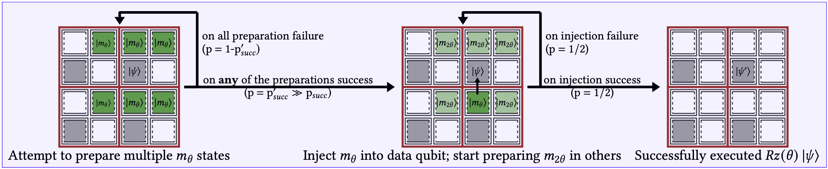
Introduction
We propose RESCQ, a realtime scheduler for programs compiled onto these continuous angle systems.
RESCQ’s APPROACH

Slide 5
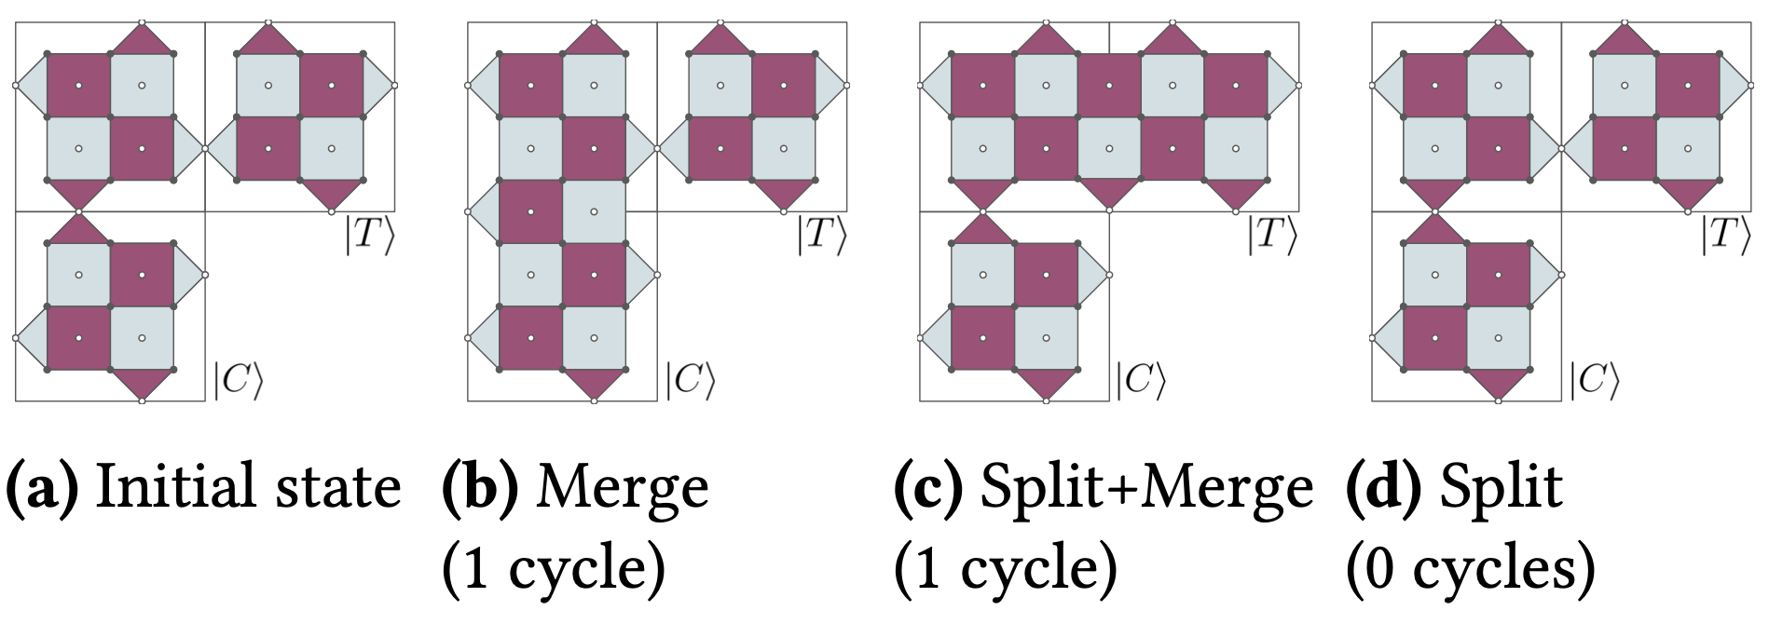
Surface Codes and Lattice Surgery
Surface codes are a class of QEC codes that have many attractive properties for available or soon-to-be available quantum hardware platforms.
They require only nearest neighbour connectivity, have low-depth parity checks, and high thresholds.
Operations on surface codes can be performed using lattice surgery

Slide 6
Execution of CNOT Gate
CNOT gates are executed on surface codes using lattice surgery.
Lattice surgery requires a contiguous path of (non-empty) ancilla tiles between the Z edge of the control qubit and the X edge of the target qubit.
Such a path may not always exist due to ancilla unavailability.
We then need to insert an edge-rotation gate to expose the required edge of the qubit onto the chosen path.
Notes:
We talk in the context of surface codes, but our techniques extend to any code that supports lattice surgery
Such a path may not always exist, either due to the ancilla being occupied for another gate operation, or the required edges not having any ancilla neighbours.
This gate operation requires a free neighbouring ancilla tile and takes 3 lattice surgery cycles

Slide 7
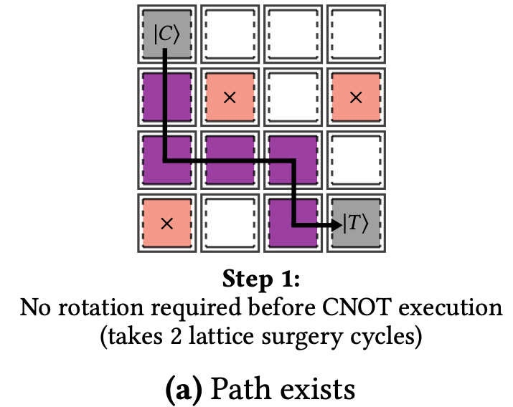
Execution of CNOT Gate: Path Exists
Lattice surgery requires a contiguous path of (non-empty) ancilla tiles between the Z edge of the control and the X edge of the target
Notes:
Lattice surgery requires a contiguous path of (non-empty) ancilla tiles between the Z edge of the control qubit and the X edge of the target qubit.
Such a path may not exist, either due to the ancilla being occupied for another gate operation, or the required edges not having any ancilla neighbours.
In either case, we need to insert an edge-rotation gate to expose the required edge of the qubit onto the chosen path.
This gate operation requires a free neighbouring ancilla tile and takes 3 lattice surgery cycles

Slide 8
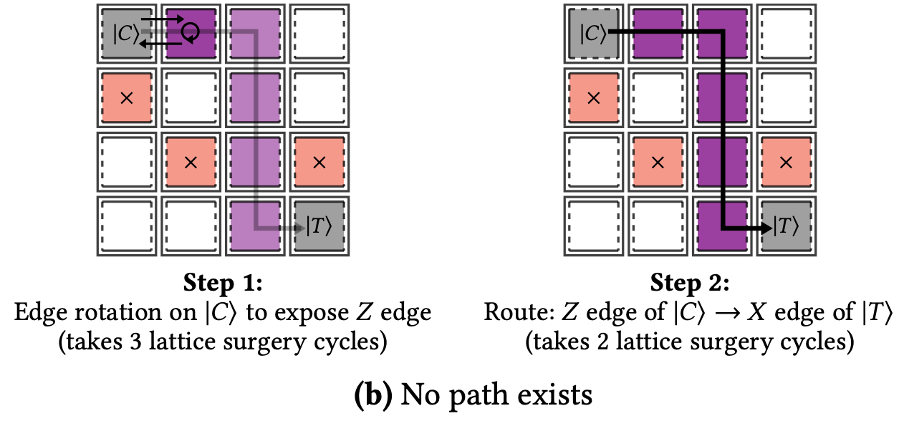
Execution of CNOT Gate: No Path Exists
Lattice surgery requires a contiguous path of (non-empty) ancilla tiles between the Z edge of the control and the X edge of the target
Notes:
Lattice surgery requires a contiguous path of (non-empty) ancilla tiles between the Z edge of the control qubit and the X edge of the target qubit.
Such a path may not exist, either due to the ancilla being occupied for another gate operation, or the required edges not having any ancilla neighbours.
In either case, we need to insert an edge-rotation gate to expose the required edge of the qubit onto the chosen path.
This gate operation requires a free neighbouring ancilla tile and takes 3 lattice surgery cycles

Slide 9
Execution of CNOT Gate
Routing algorithm and path selection are crucial to an optimal scheduler.
Static path finding techniques [16, 18], do not account for non-deterministic ancilla activity nor edge-rotation gates.
Execution is stalled until the gate with highest execution time of the current layer is completed.

Slide 10
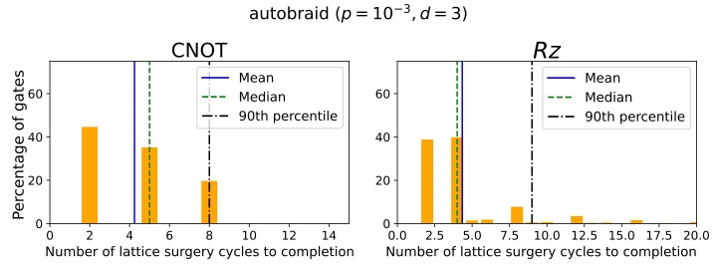
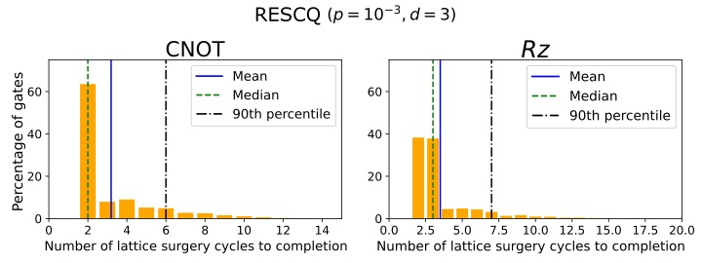
Execution of CNOT Gate
Histograms showing the time taken for CNOT and 𝑅𝑧 gates (including all correction gates) to complete after they are scheduled (accumulated over all benchmarks).
Notes:
For instance, if two CNOTs are scheduled to execute simultaneously with one CNOT taking 2 cycles and the other taking 5 cycles (due to requiring an edge rotation), the next set of gates will only be scheduled after the CNOT gate taking 5 cycles is finished.

Slide 11
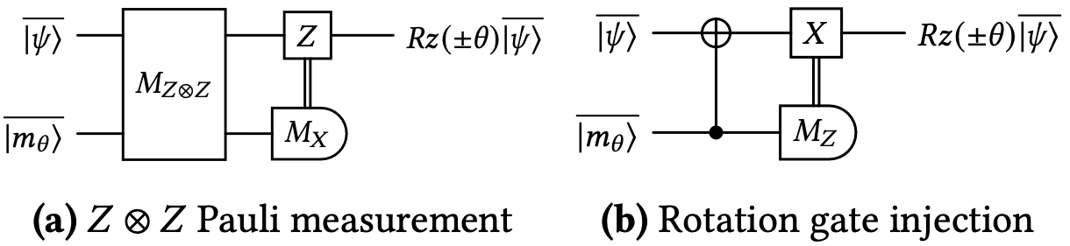
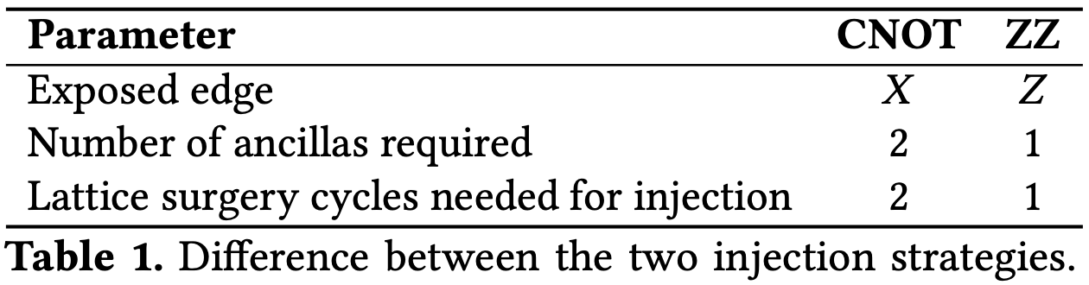
Execution of 𝑅𝑧(𝜃) Rotation Gate
The 𝑅𝑧(𝜃) rotation gate is executed in two steps,
Preparation of an ancilla qubit in the state |𝑚_{𝜃}⟩.
Injection of the |𝑚_{𝜃}⟩ state into the data qubit and measurement.

Slide 12
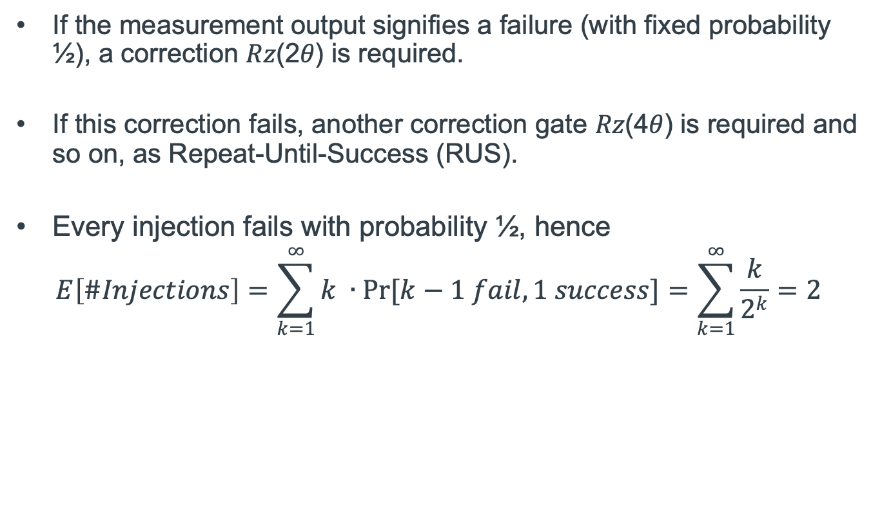
Execution of 𝑅𝑧(𝜃) Rotation Gate
If the measurement output signifies a failure (with fixed probability ½), a correction 𝑅𝑧(2𝜃) is required.
If this correction fails, another correction gate 𝑅𝑧(4𝜃) is required and so on, as Repeat-Until-Success (RUS).
Every injection fails with probability ½, hence
$$E\left[\#Injections\right]=\sum_{k=1}^{∞}{k ∙Pr[k−1 fail, 1 success]}=\sum_{k=1}^{∞}{\frac{k}{2^{k}}}=2$$
Notes:
Failed injection means an 𝑅𝑧(−𝜃)gate was executed so executing an 𝑅𝑧(2𝜃)correction gate would yield the proper rotation.

Slide 13
Execution of 𝑅𝑧(𝜃) Rotation Gate
BASELINE APPROACH
RESCQ’s APPROACH

Slide 14
RESCQ: Realtime Scheduling Framework
Our proposed solution relies on two dynamically constructed and modified data structures throughout execution:
A dynamically recomputed minimum spanning tree (MST) weighted by historical use for routing, combined with
A queue for every ancilla qubit in the system

Slide 15
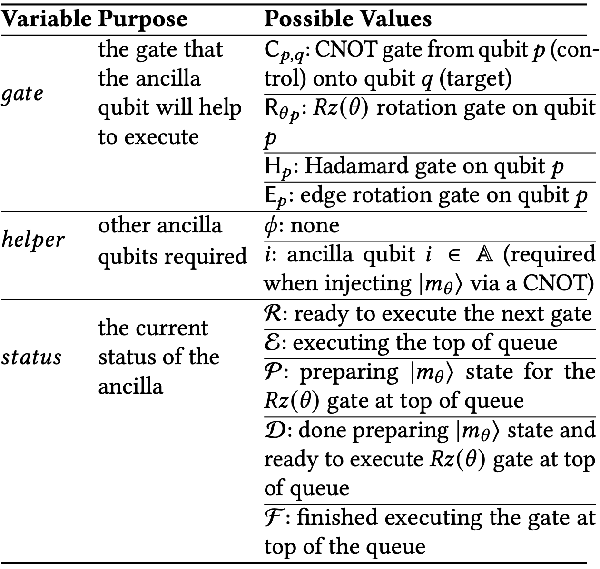
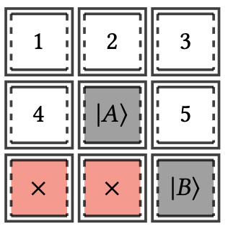
Managing Ancilla Operations
To execute a R_{𝜃𝐴} gate,
We enqueue the gate in the queue of ancilla 2 (for 𝑍𝑍 type injection).
We enqueue the gate into ancillas 1 and 3 (for CNOT type injection). It is also enqueued into ancillas 4 and 5 (respectively) as helper.
This happens pre-emptively to minimise the time 𝐴 spends idling.

Slide 16
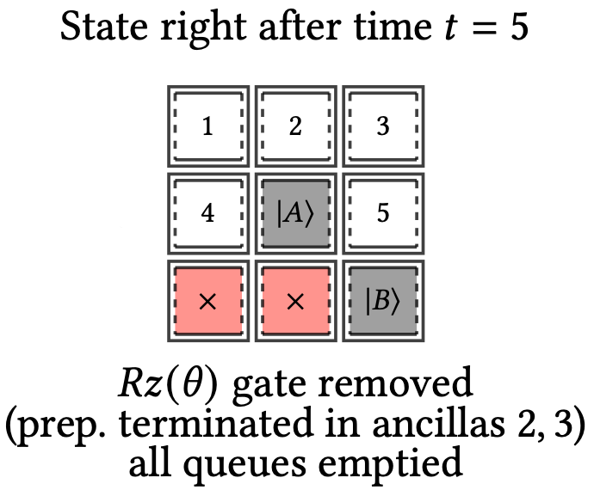
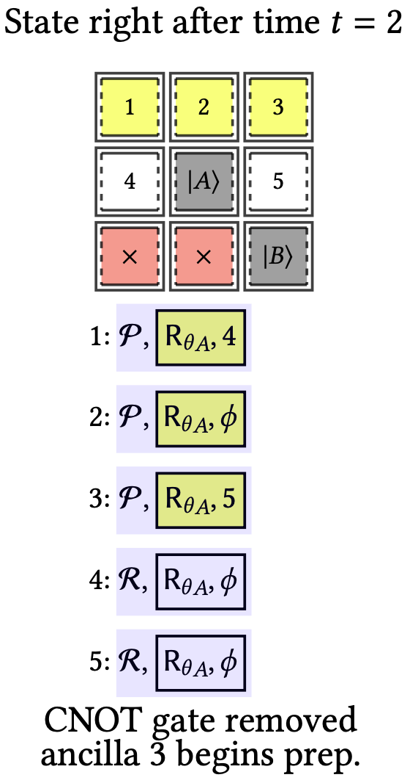
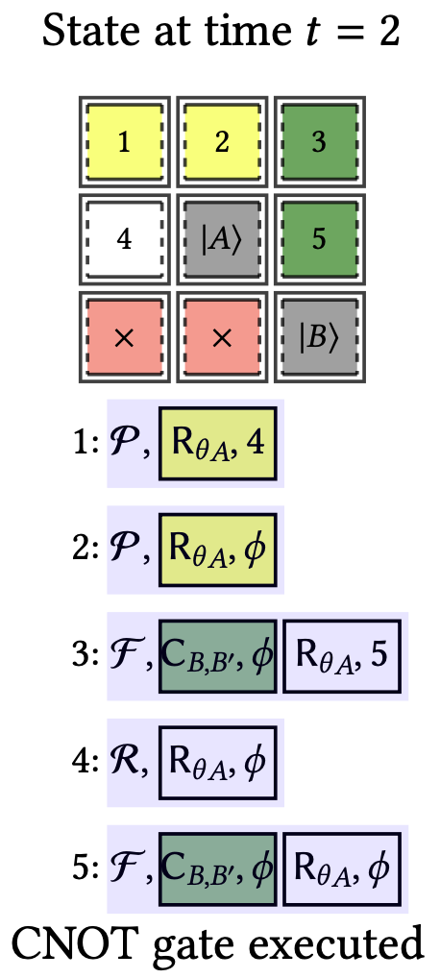
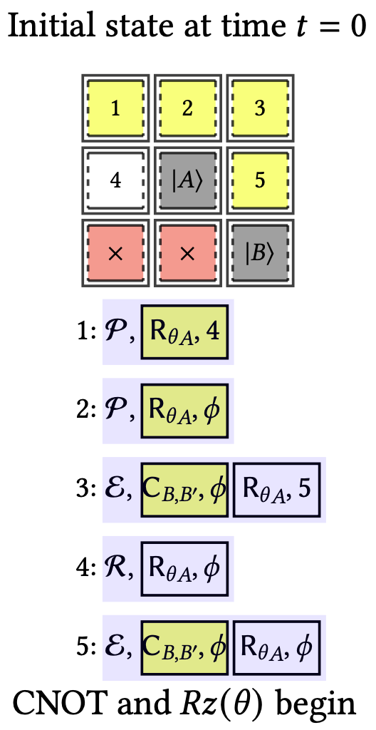
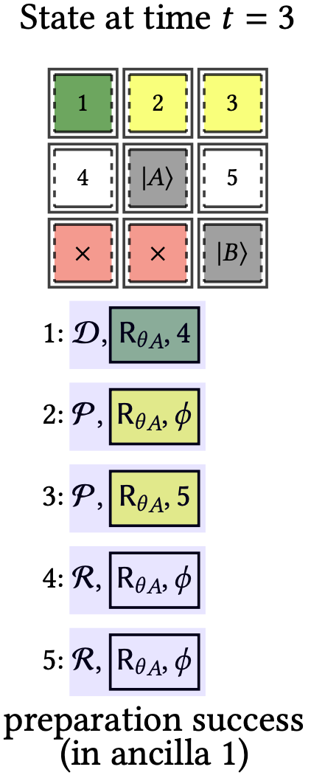
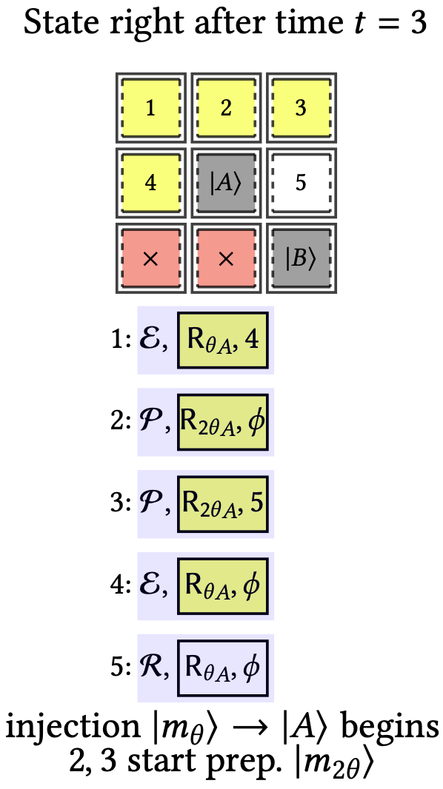
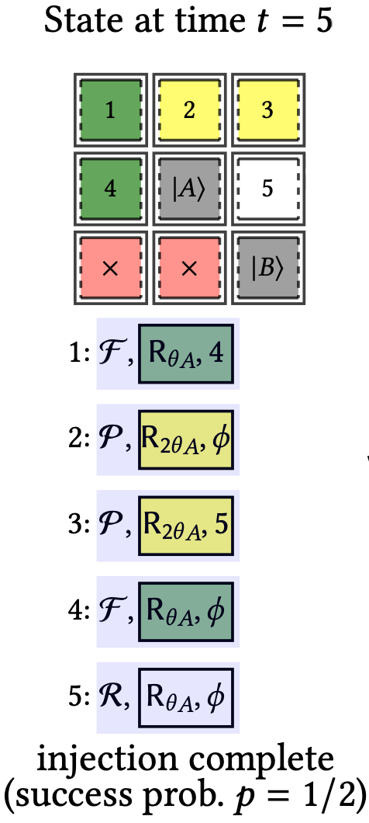
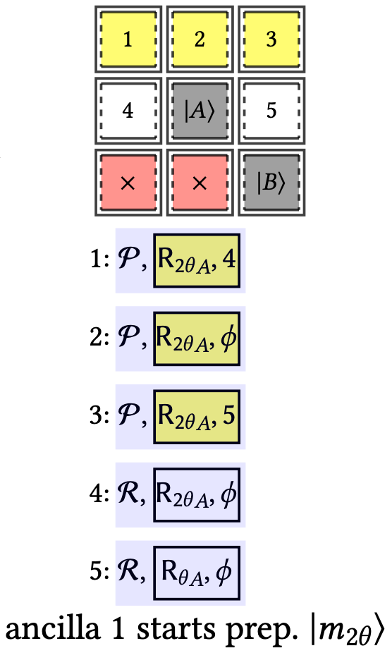
Managing Ancilla Operations
success
failure

Slide 17
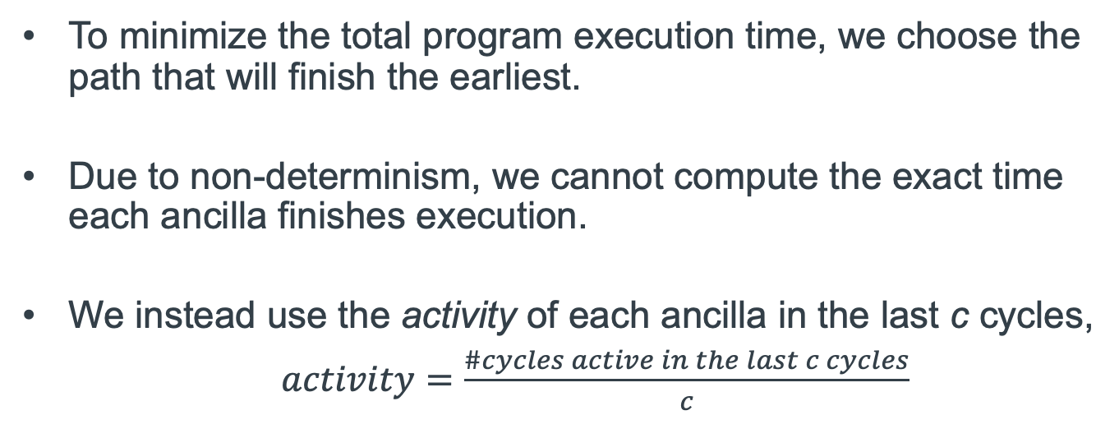
Efficient Path Finding
To minimize the total program execution time, we choose the path that will finish the earliest.
Due to non-determinism, we cannot compute the exact time each ancilla finishes execution.
We instead use the activity of each ancilla in the last c cycles,
$activity=\frac{\#cycles active in the last c cycles}{c}$
Notes:
Even if a path exists that starts earlier, it might not finish the earliest if it requires an edge-rotation gate.

Slide 18
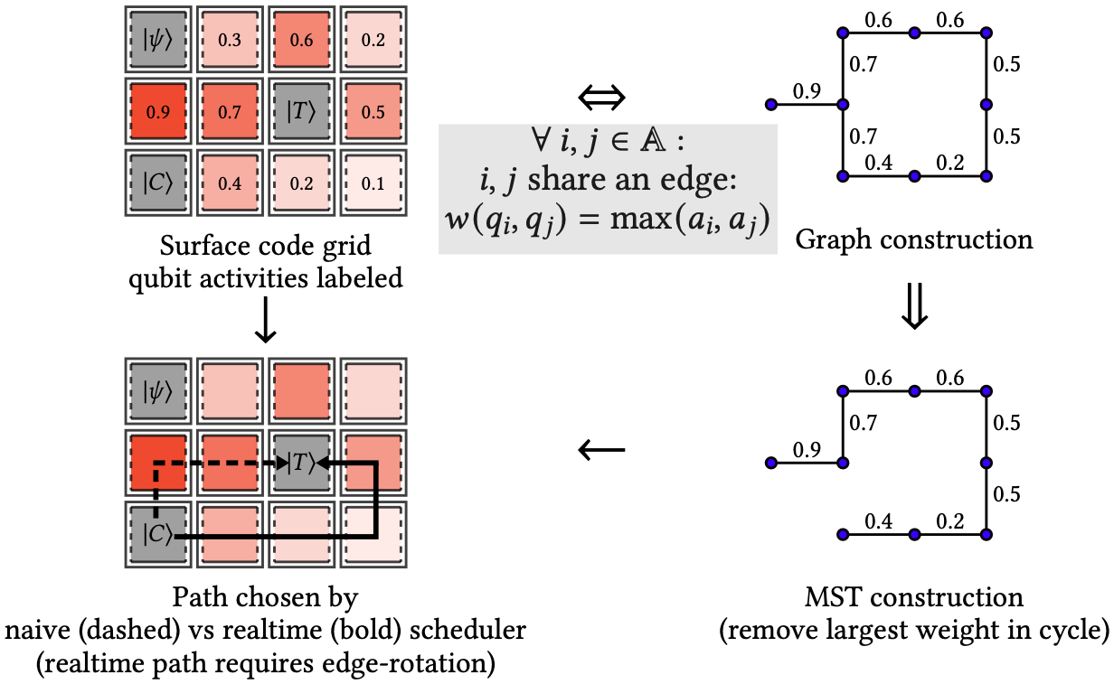
Efficient Path Finding
We then compute the MST on the grid of ancillas.
The path between all pairs of vertices on the MST has the least maximum [7].
Therefore, the path for any CNOT obtained from the MST will have the least maximum activity and will begin the earliest in expectation.

Slide 19
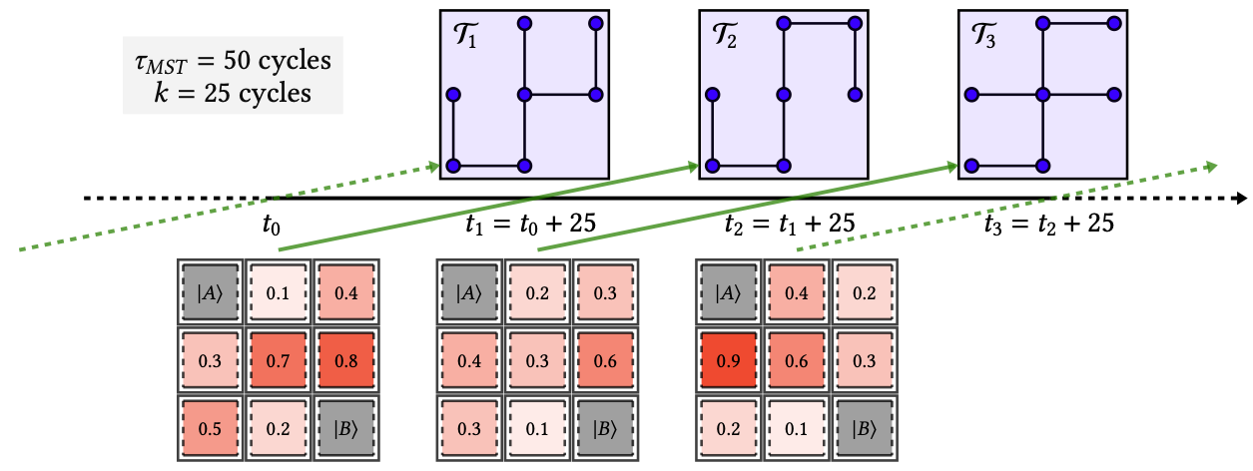
Efficient Path Finding
However, the MST computation is slow and can take up to 100 cycles (𝜏_{𝑀𝑆𝑇}).
To overcome this barrier, we recompute the MST every 𝑘 cycles and use the stale information instead of stalling.

Slide 20
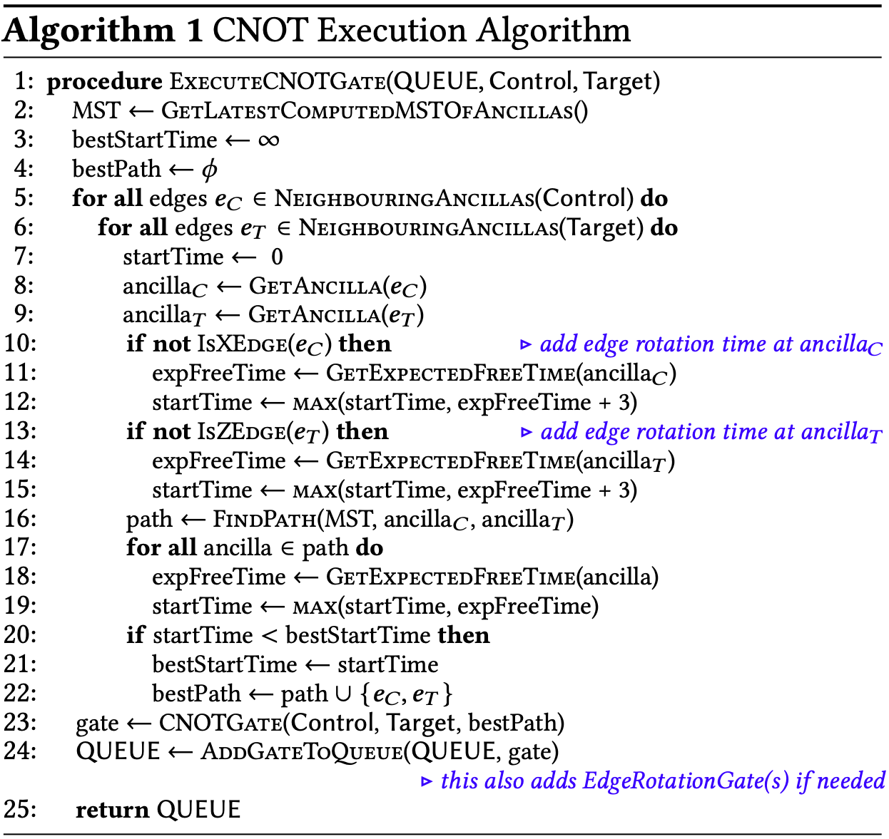
Efficient Path Finding
To account for edge rotation, we compute paths from each of the 4 edges of control to each of the 4 edges of the target.
We then pick the path which will finish the earliest in expectation.

Slide 21
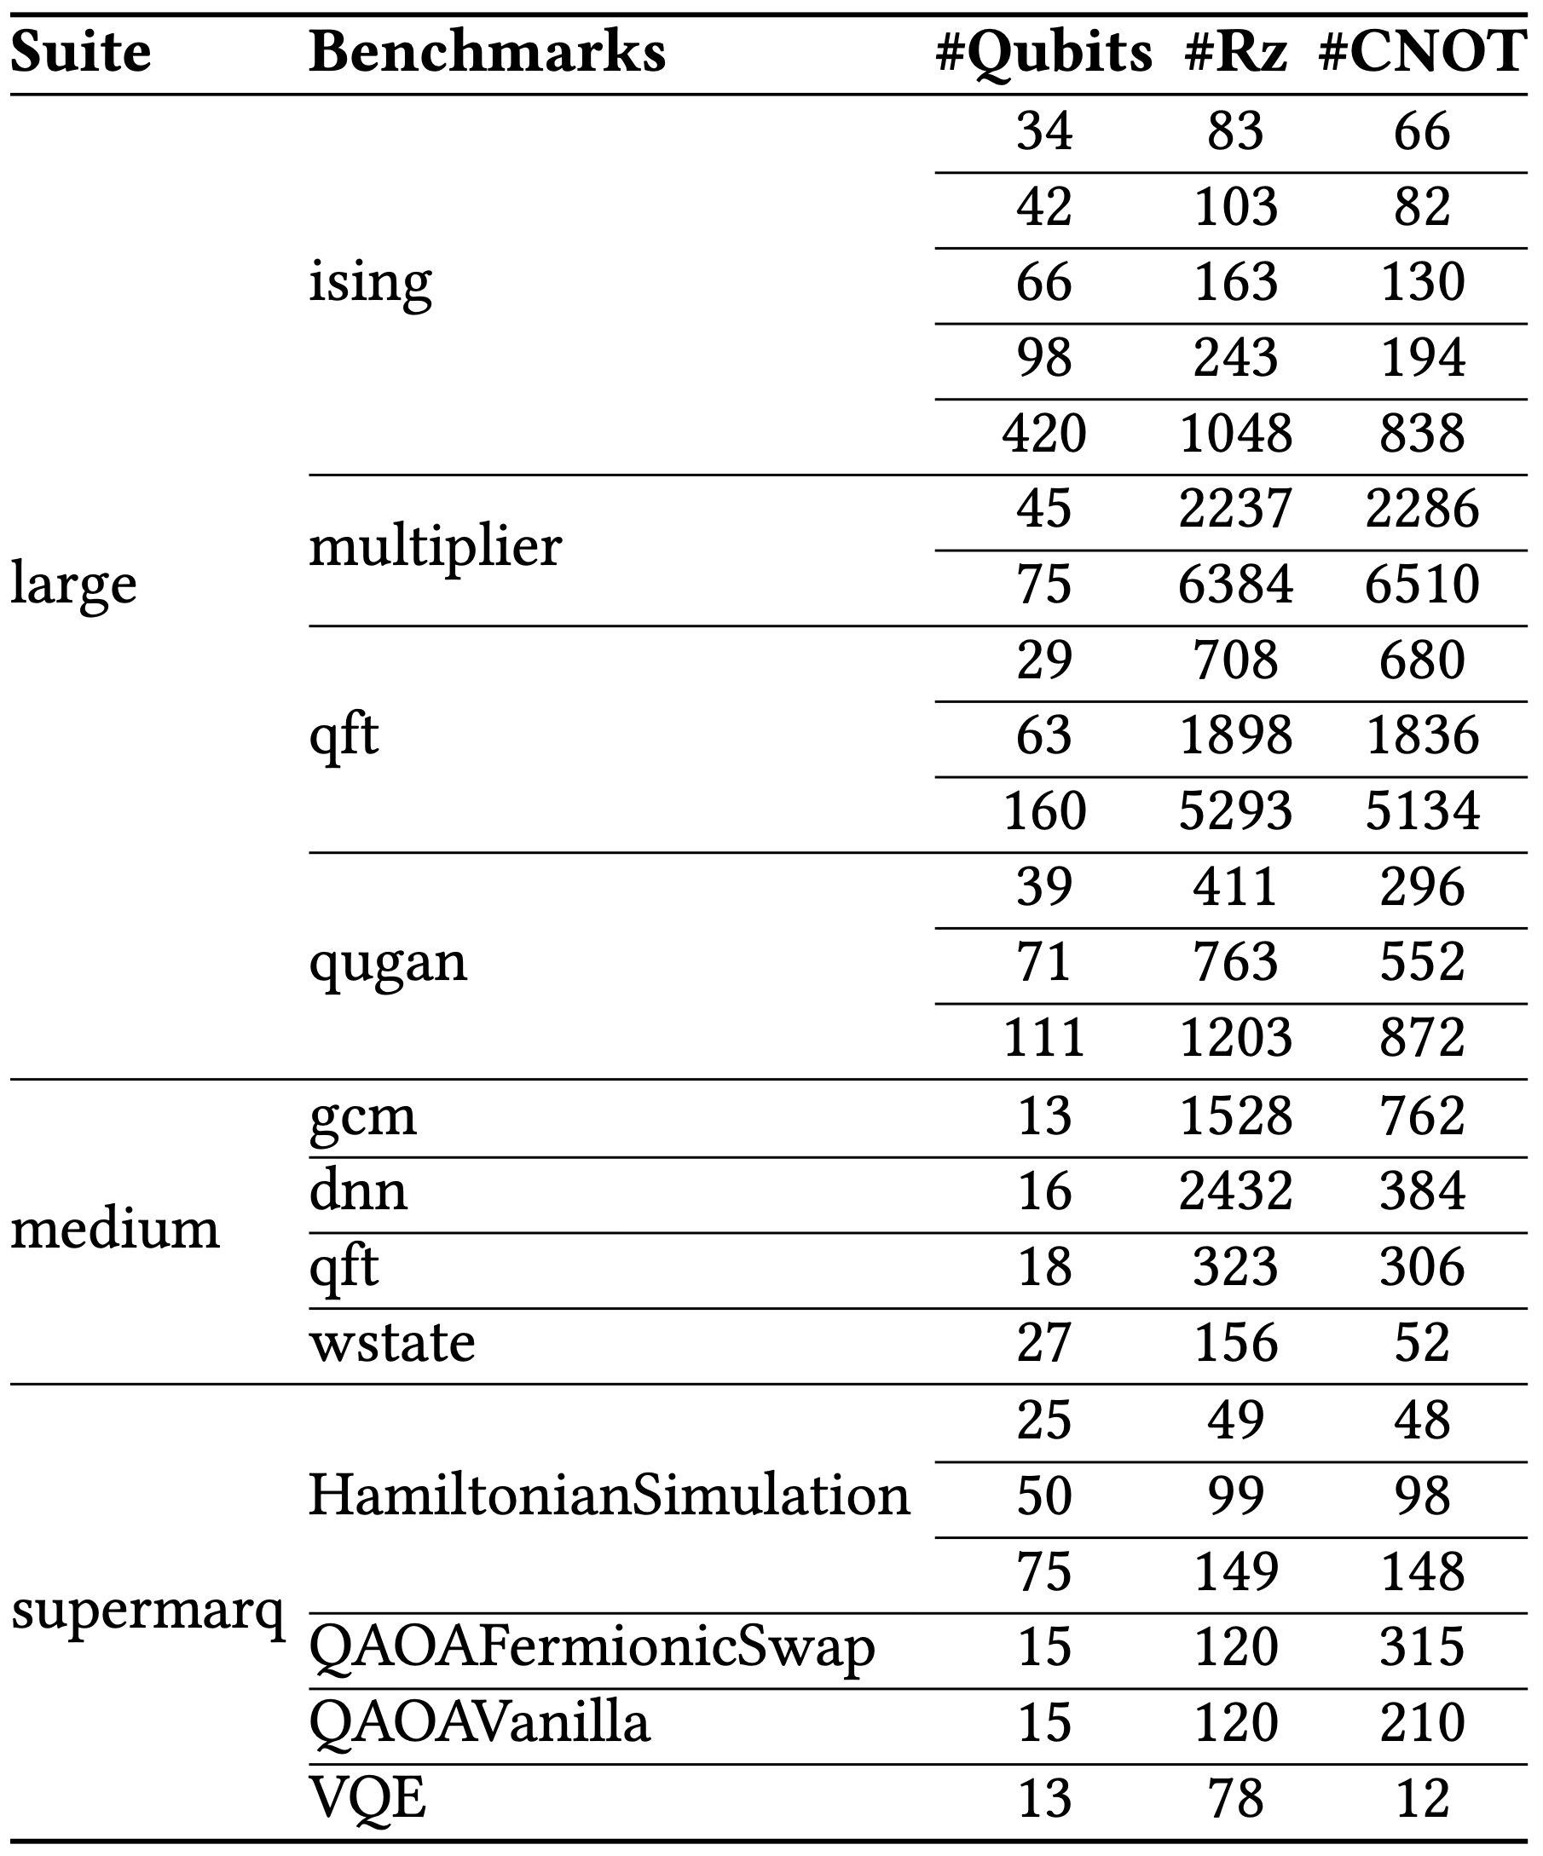
Baselines and Benchmarks
We augment the baseline strategy with two different path-finding strategies: greedy [18] and AutoBraid [16].
We evaluate RESCQ on multiple workloads with varying (#Rz):(#CNOT) from [21, 33]
Notes:
QASMBench and Supermarq

Slide 22
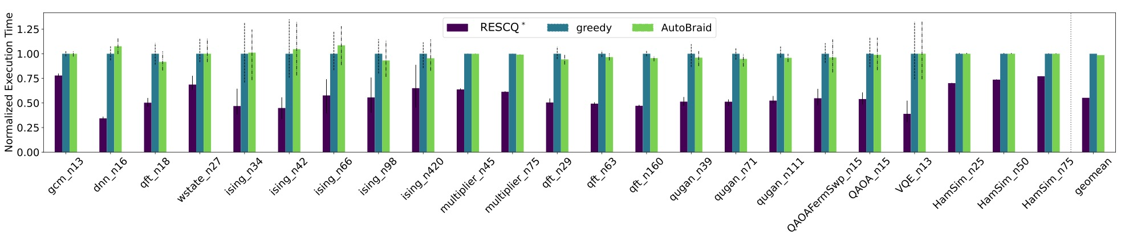
Evaluation
Normalized average execution time for RESCQ versus the baseline schemes. The above plot is for 𝑑=7 and p=10⁻⁴. We compute execution time for 𝑘 ∈ {25, 50, 100, 200} and report best average as 𝑅𝐸𝑆𝐶𝑄∗. Error bars show minimum and maximum execution times in black. We report the geometric mean across all the benchmarks.

Slide 23
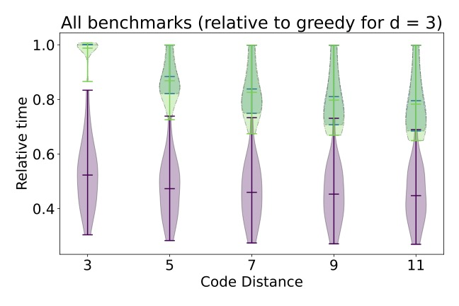
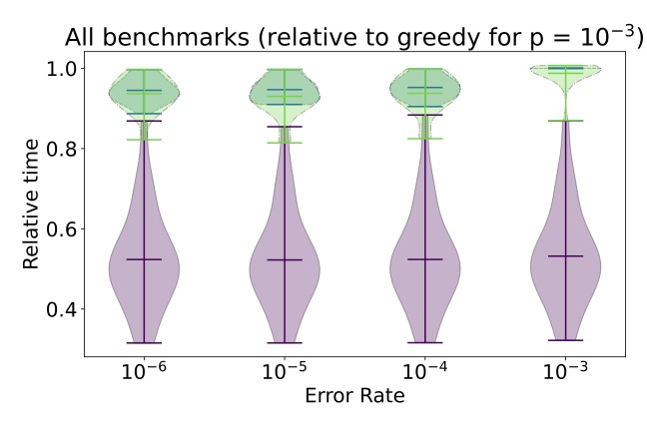
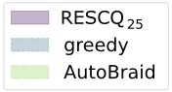
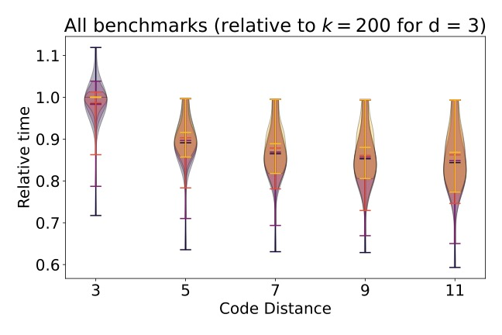
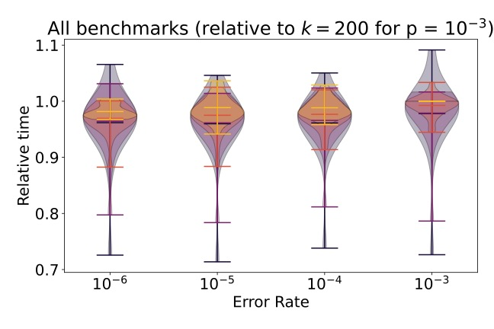
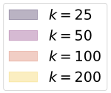
Sensitivity Analysis
Sensitivity of all schemes to 𝑑 and p
Sensitivity of RESCQ to changing the MST Frequency 𝑘

Slide 24
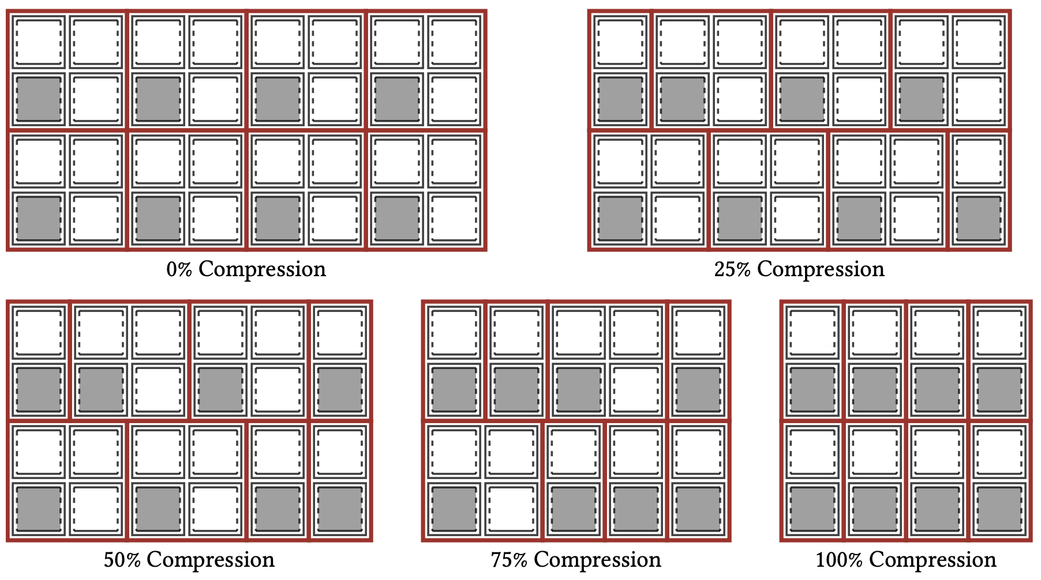
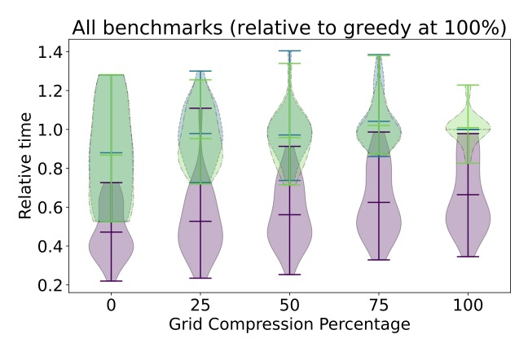
Hardware-Software Codesign
We explore the trade-off for reducing the number of ancillas in the grid by incrementally compressing the grid.

Slide 25


Conclusion
Continuous rotation angle architectures have been proposed that allow for localized, low-latency ancilla preparation in the required states.
However, these proposals have lacked realtime ancilla allocation support, incurring unnecessary time overhead.
We tackle this problem and propose RESCQ, a realtime scheduler that utilizes variable ancilla activity to perform efficient allocation of different gate operations in parallel, thus minimizing total program execution time.
We improve significantly over the baseline proposals while simultaneously minimizing classical overhead for realtime recomputation.

